Slide 1



Youtube Trends Data Analytics Platform
What’s trending?
Alexander Tanskii & Yaron Gibli - 12/2025
Big Data & Cloud Engineer course, Naya College

Slide 2

Introduction
The YouTube Trends Data Analytics Platform is an end-to-end system built to collect, process, and analyze trending YouTube data in near real time. It transforms raw API data into structured, analytics-ready datasets that reveal how videos gain traction across regions, languages, and categories.
The platform is designed to track engagement metrics such as views, likes, and comments over time. By combining streaming ingestion, incremental processing, and a lakehouse + warehouse architecture, it enables reliable trend analysis, historical comparisons, and scalable analytics similar to real-world production data systems.
Notes:
YouTube is one of the largest and most influential content platforms in the world. Every day, billions of hours of video are watched, with millions of new videos uploaded by creators across a wide range of topics, languages, and regions.
The platform is not only a source of entertainment, but also a major hub for news, education, music, and digital marketing. Content performance on YouTube is highly dynamic and driven by user engagement, recommendation algorithms, and regional trends, making it a rich and complex ecosystem for data analysis.

Slide 3

Content
Idea
Goal
The Stack
Architecture
The containers
Project Architecture
Platform architecture
Airflow orchestration
Data lineage and DB Structure
Code examples
Use cases
Tableau
Power BI
Challenges
Q&A and Wrap up
Notes:
YouTube is one of the largest and most influential content platforms in the world. Every day, billions of hours of video are watched, with millions of new videos uploaded by creators across a wide range of topics, languages, and regions.
The platform is not only a source of entertainment, but also a major hub for news, education, music, and digital marketing. Content performance on YouTube is highly dynamic and driven by user engagement, recommendation algorithms, and regional trends, making it a rich and complex ecosystem for data analysis.

Slide 4


Idea
The platform is built to provide a comprehensive and structured understanding of how content trends on YouTube. It captures and analyzes trending videos over time, focusing on virality, longevity, and engagement dynamics across different regions, languages, and content categories.
Rather than treating trends as isolated daily snapshots, the platform views them as evolving signals. By continuously monitoring changes in performance and audience interaction, it turns YouTube’s highly dynamic ecosystem into a consistent and comparable source of insights that reflects real user behavior at scale.

Slide 5

Goal
The primary goal of the platform is to support data-driven decision making in content creation and digital marketing. It enables stakeholders to move beyond intuition by offering measurable indicators of what content performs well, where it performs best, and how long it remains relevant.
Specifically, the platform aims to:
Identify emerging trends early and track their lifecycle
Compare content performance across regions, languages, and markets
Understand audience engagement patterns and growth over time
Support strategic decisions around content planning, distribution, and market targeting
By delivering clear and actionable insights, the platform helps creators, brands, and media teams improve content effectiveness, optimize reach, and align strategy with actual audience demand.

Slide 6


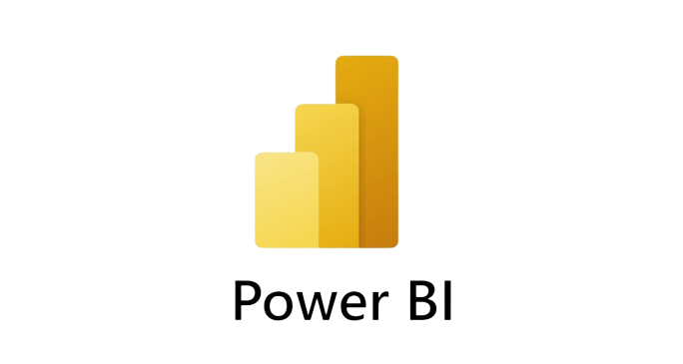




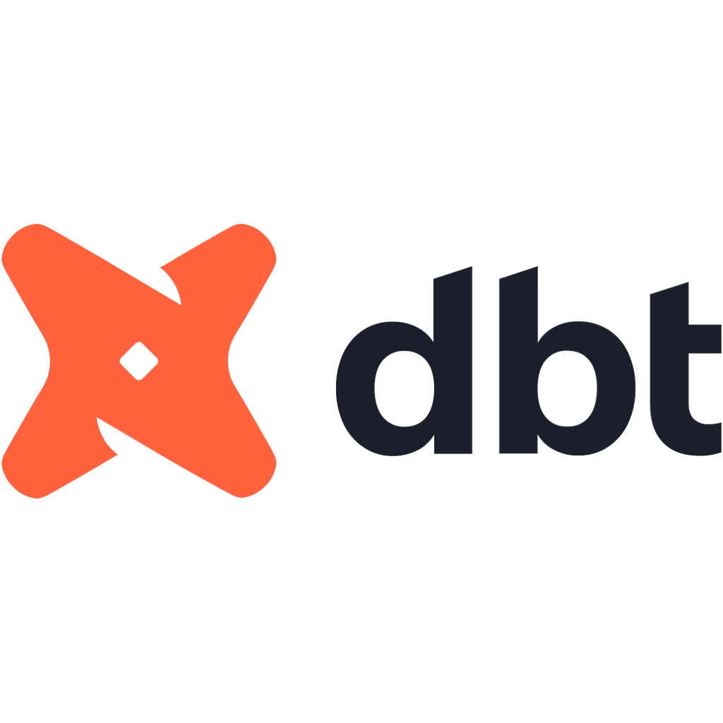











The Stack
Python | Docker | Kafka | Zookeeper | PySpark | Airflow | MinIO | Iceberg + Parquet | Hive metastore | PostgresDB | DBT | Trino | DBeaver | Tableau & Power BI
Used for retrieving data from API and ingesting into kafka | Platform for running containers | Used for queueing messages | Orchestrates kafka brokers | Used for ingesting data in batches, streaiming and transformations via DBT | Orchestrates the processes (ingestion, transformations) | Object storage sirvice | Table format chosen for the platform | Manages metadata about Iceberg tables | Used for storing airflow metadata and hive metastore (2 separate DBs) | Data transformation tool, runs on Spark via thrift server. | SQL engine, connects to Hive metastore (Iceberg tables in MinIO) | SQL client for querying data (viaTrino) | Data visualization tools

Slide 7
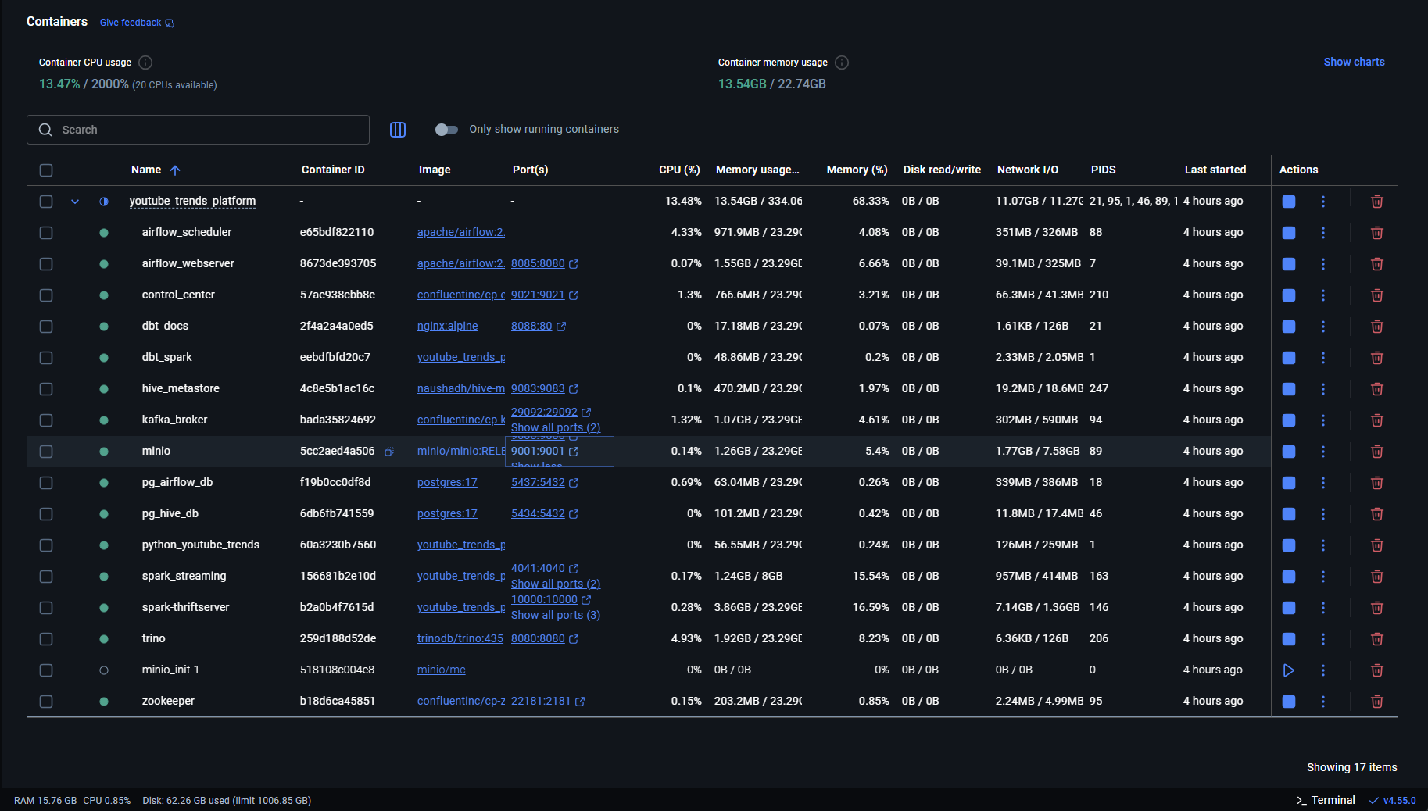
The Containers

Slide 8
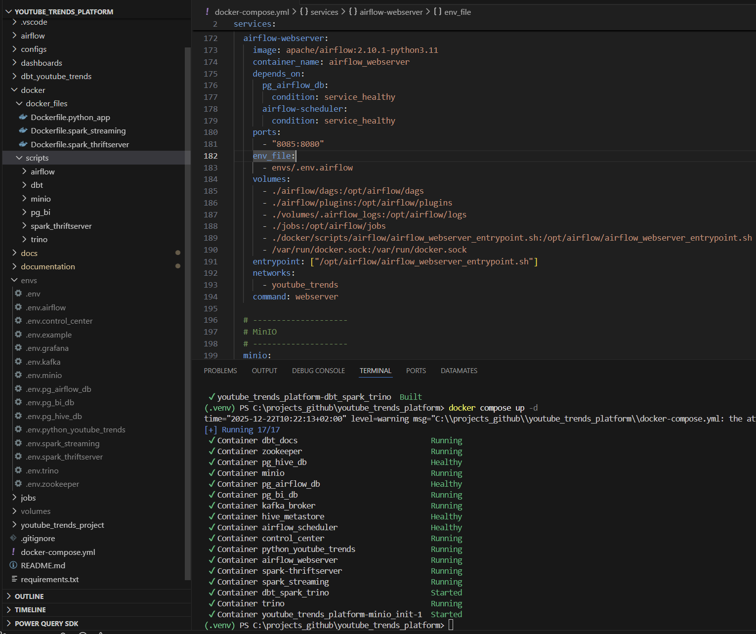
Project Structure

Slide 9

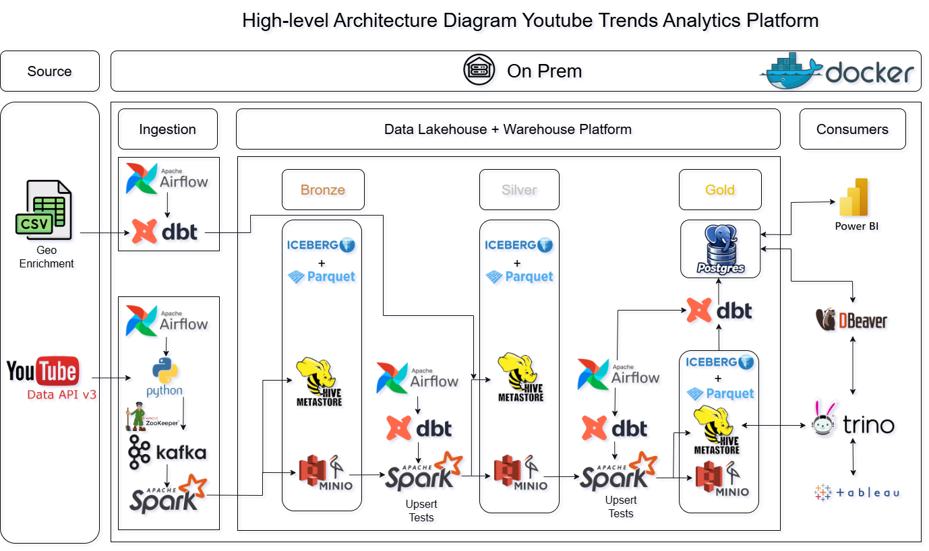
Platform Architecture

Slide 10

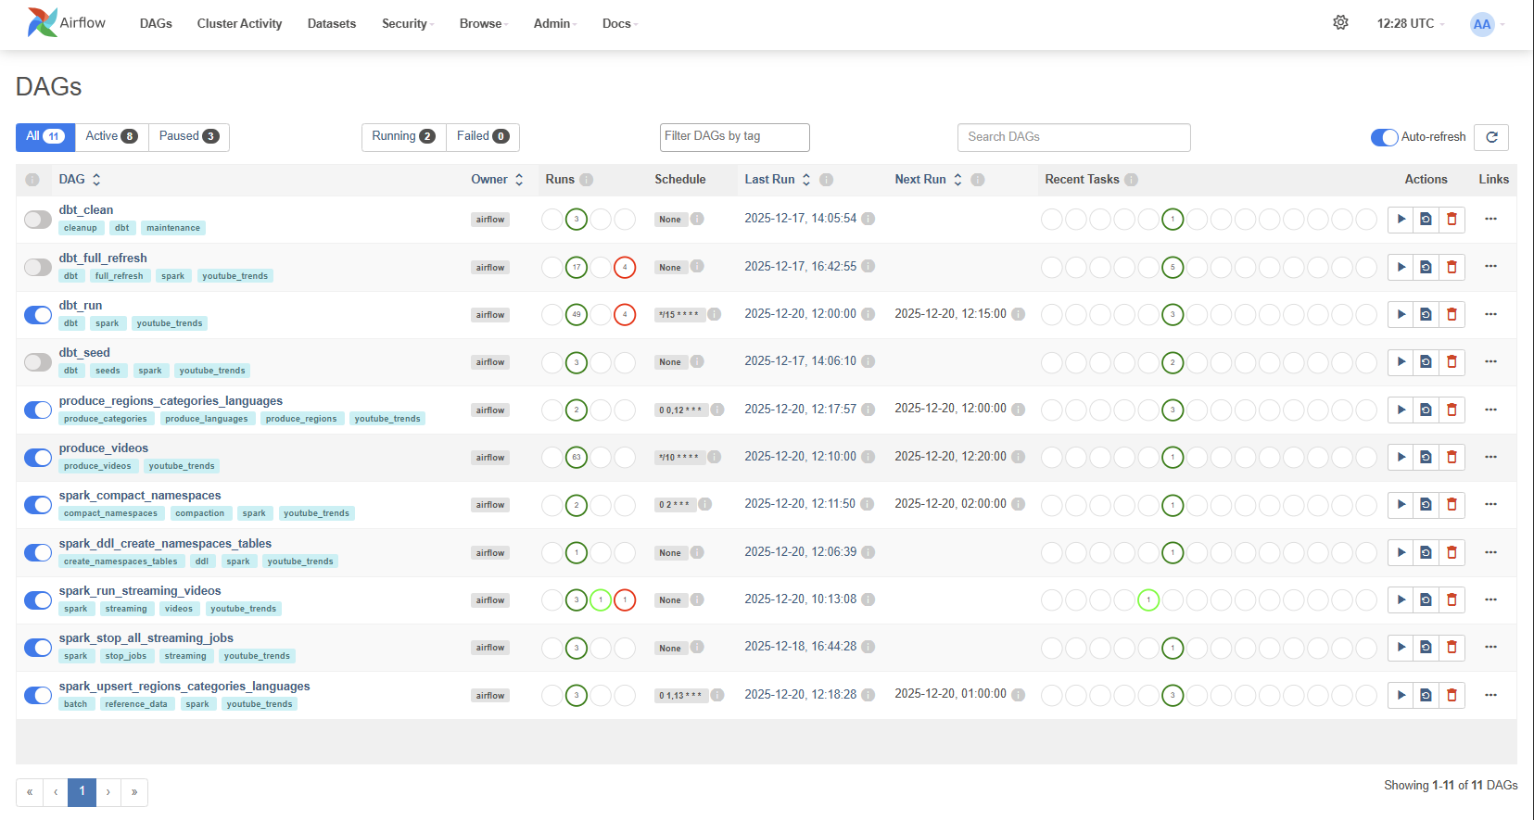

Airflow Orchestration
Notes:
This view shows the project’s orchestration layer in Airflow.
Most workflows are responsible for starting and maintaining long-running processes, such as Spark streaming jobs and data ingestion pipelines.
The main exception is the update and maintenance workflow, which runs on a fixed schedule, monitors active jobs and system state, and applies updates or maintenance actions when needed.

Slide 11

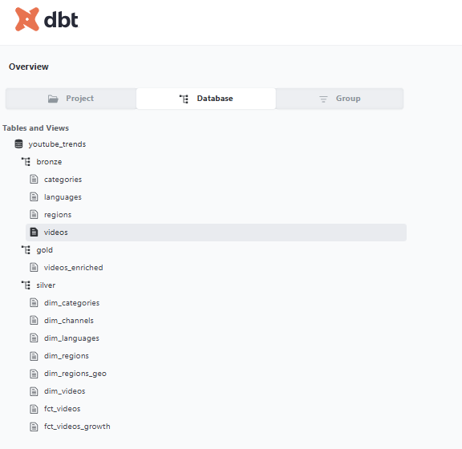
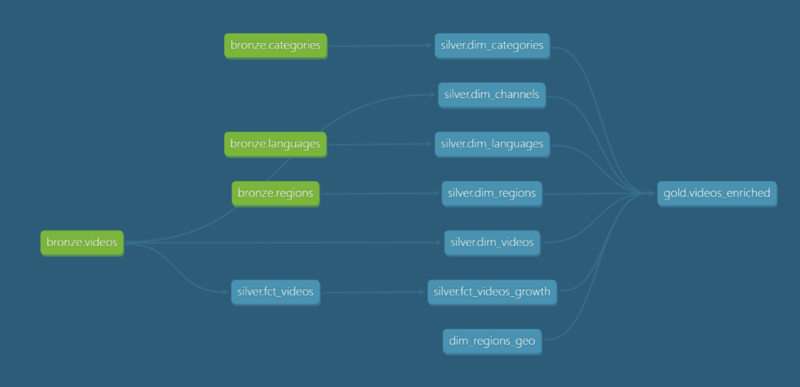

Data Lineage and DB Structure

Slide 12
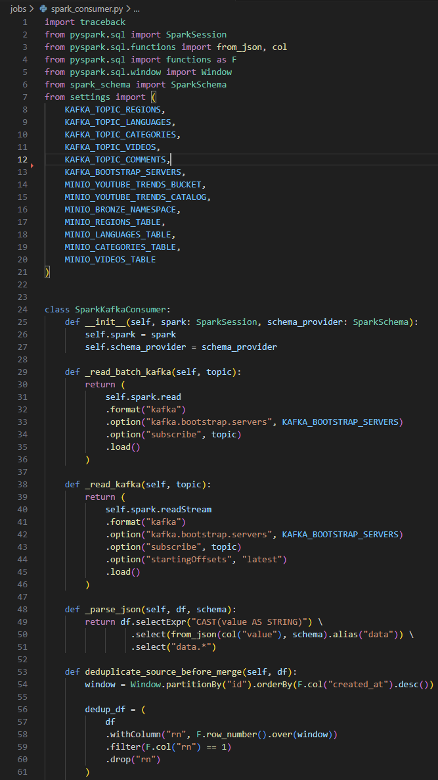
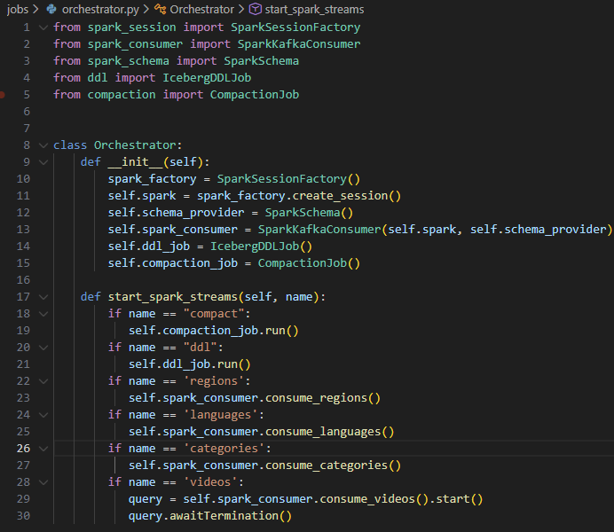
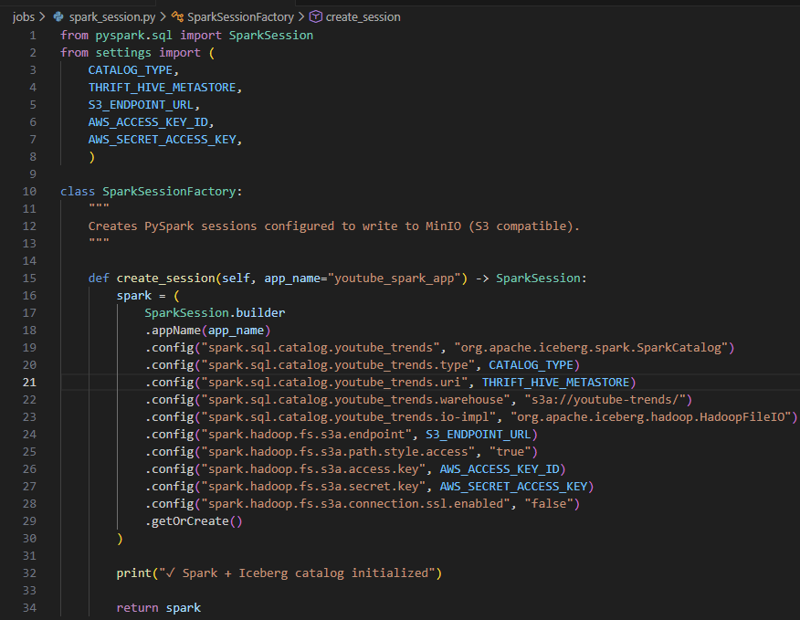


Videos Data Ingestion

Slide 13
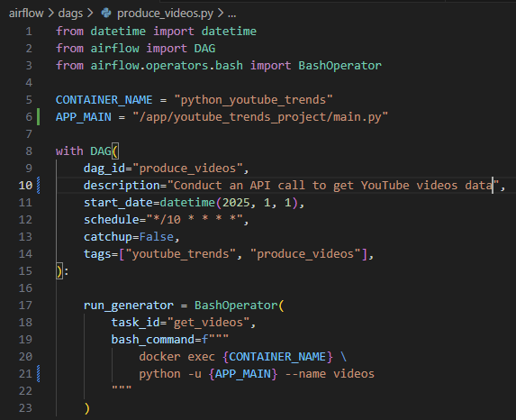
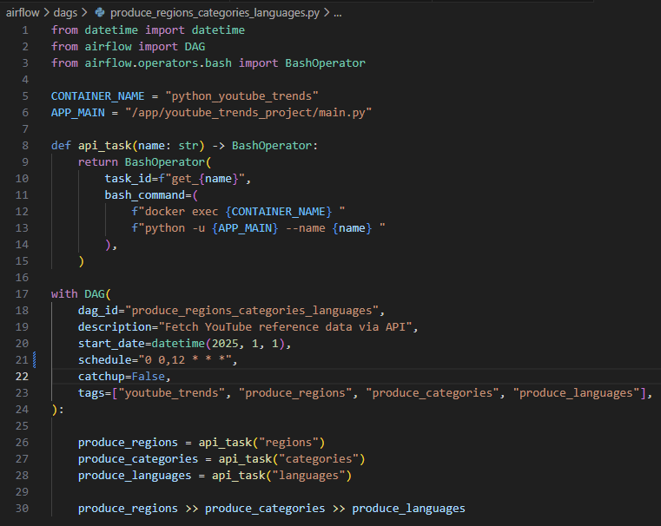
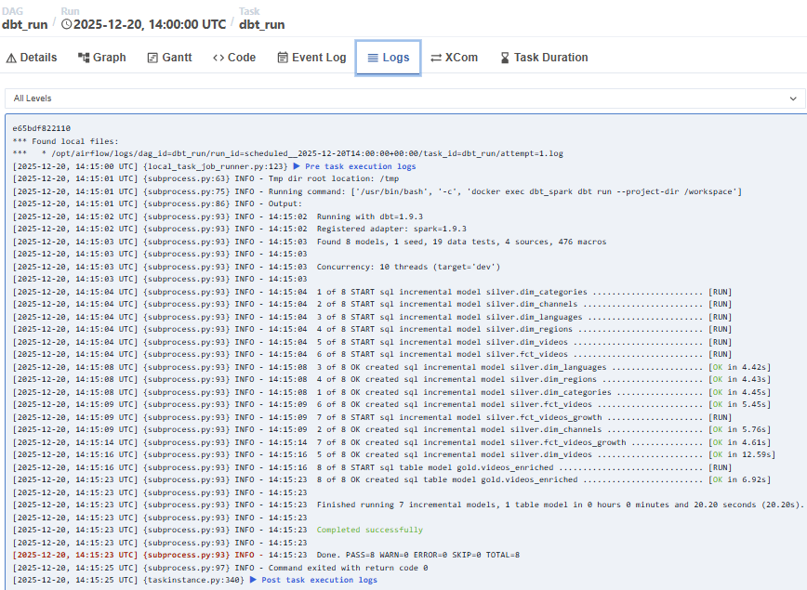

Code Examples and a run of DAGs

Slide 14

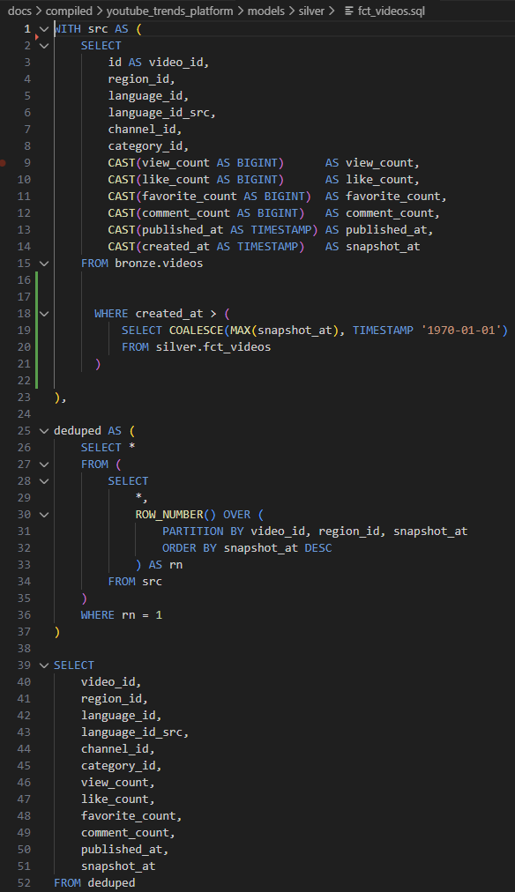
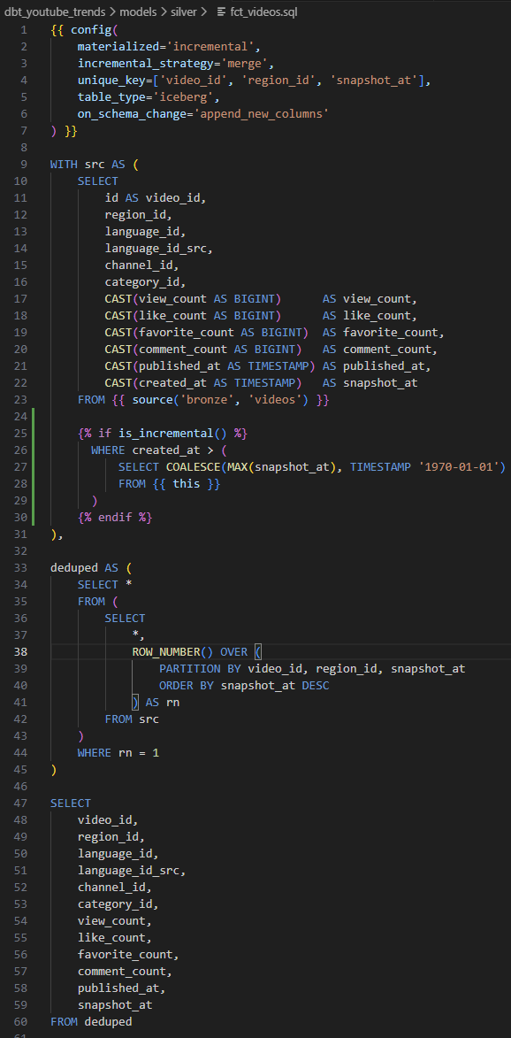
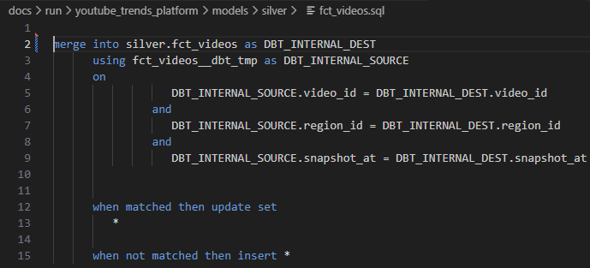

Code Examples DBT model
The model follows dbt best practices for incremental processing on Iceberg, ensuring efficient and reliable data updates at scale:
Incremental Iceberg model uses Jinja configuration and defined unique keys
Processes only new or updated records on each run
Writes the computed delta into a temporary staging table
Applies changes to the target table using a MERGE (upsert) operation

Slide 15
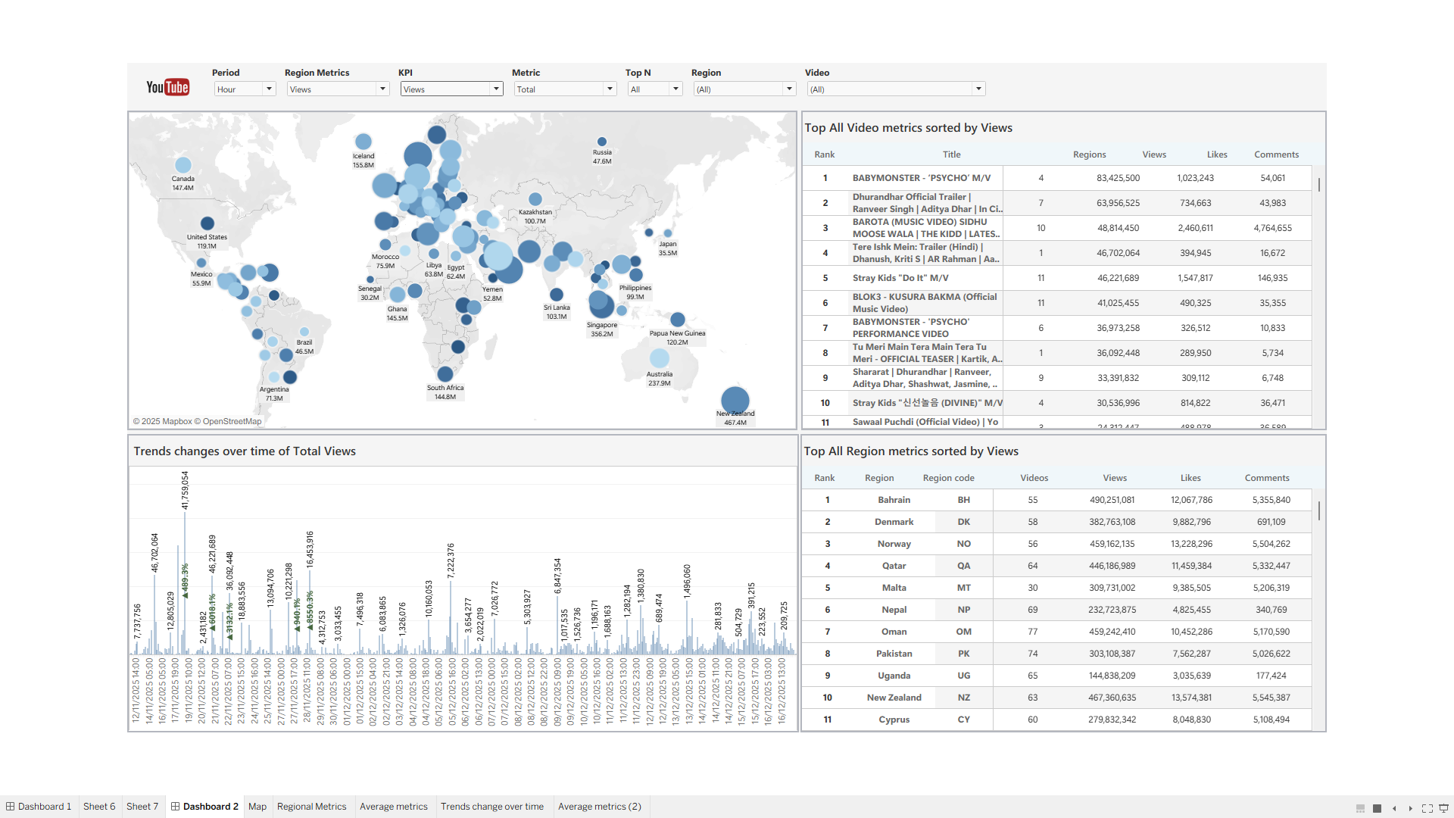
Use cases

Slide 16
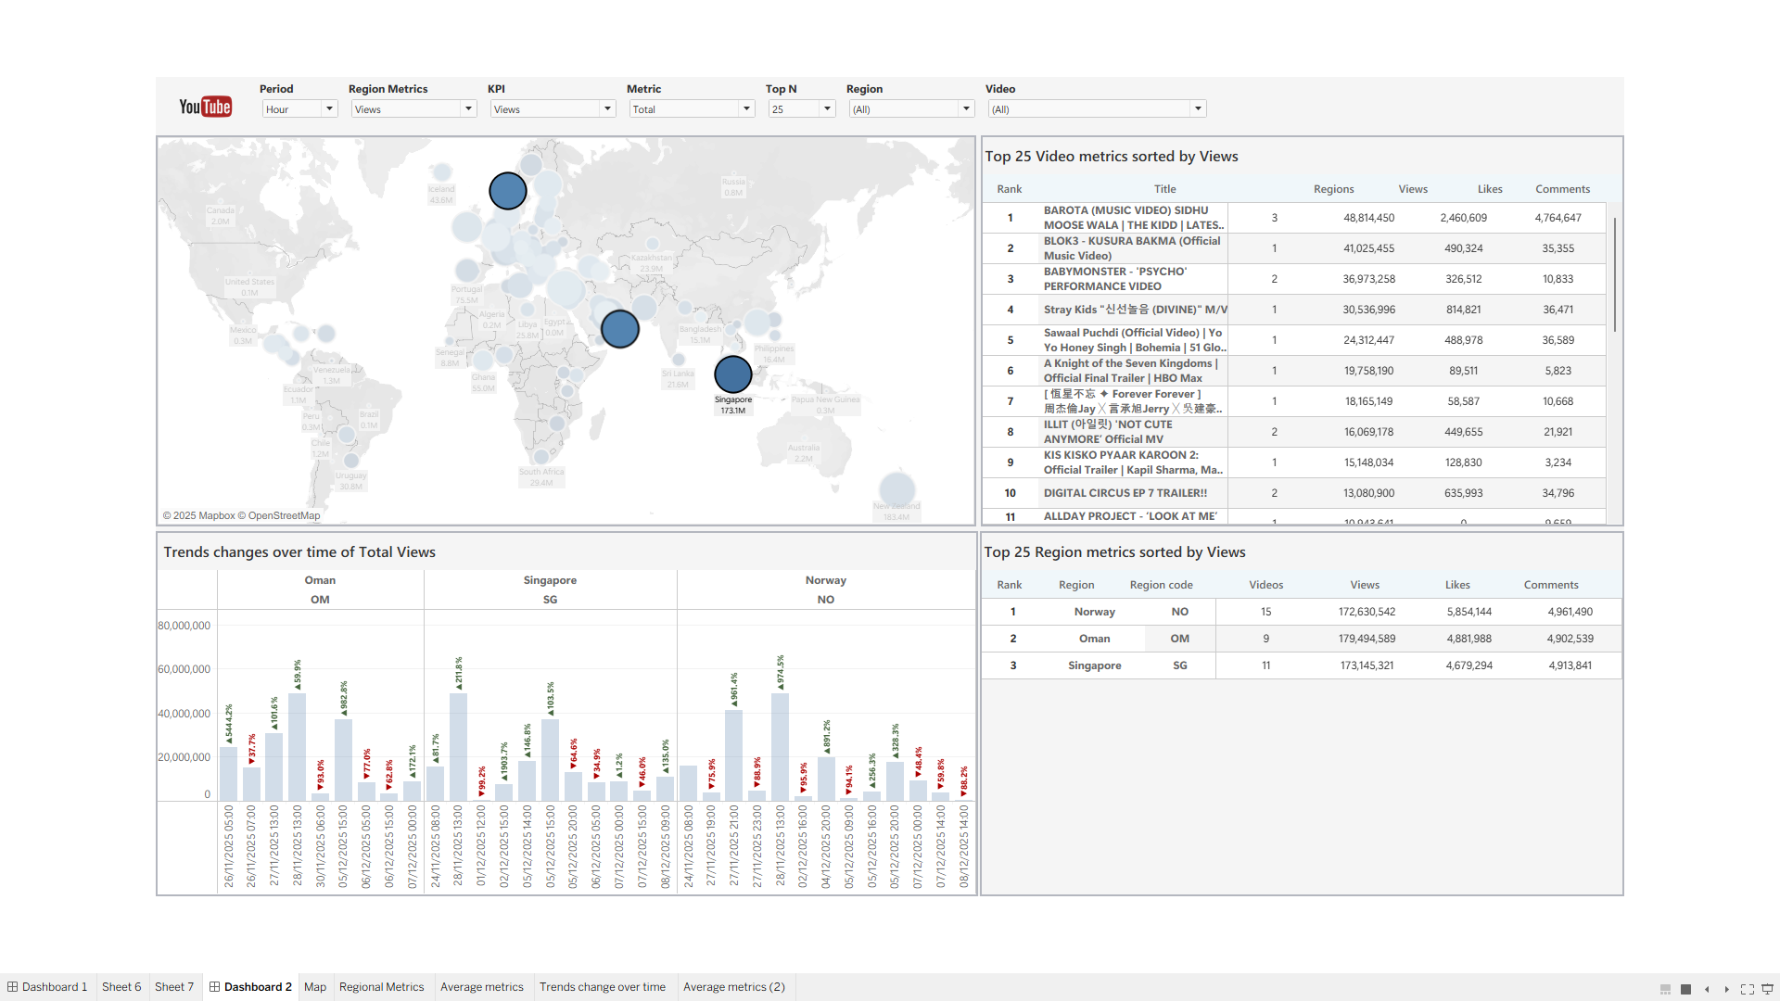
Use cases

Slide 17
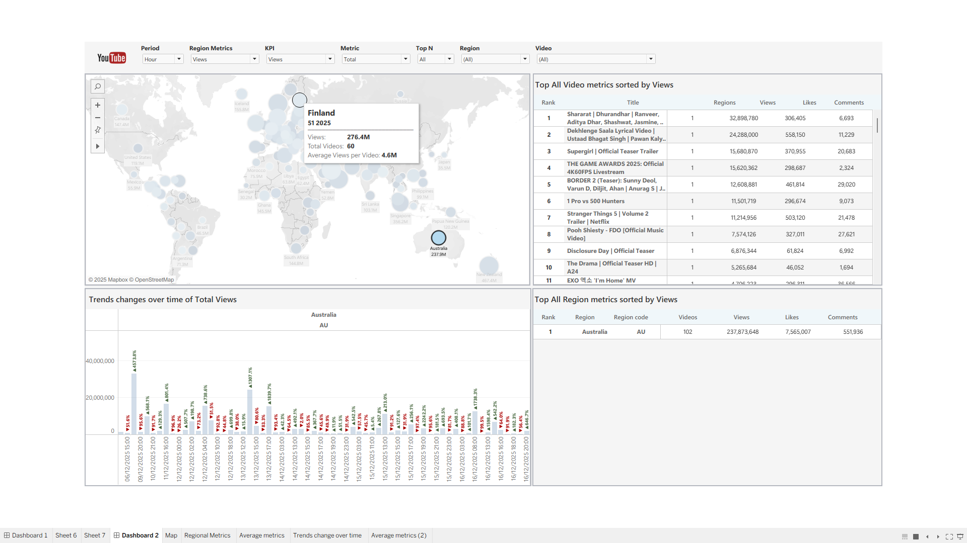
Use cases

Slide 18
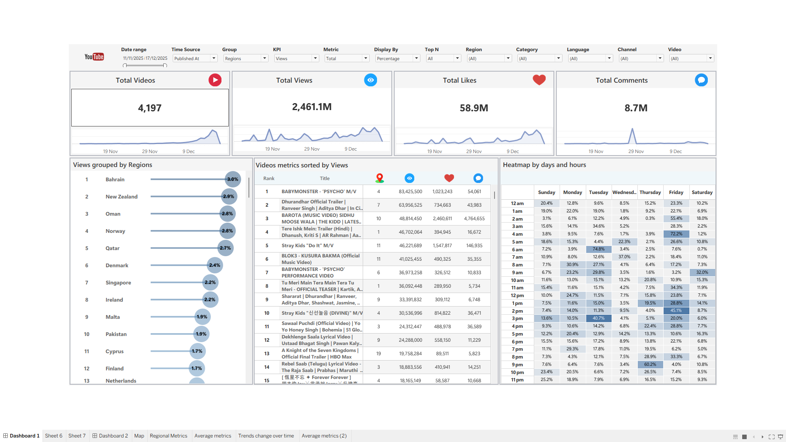
Use cases

Slide 19
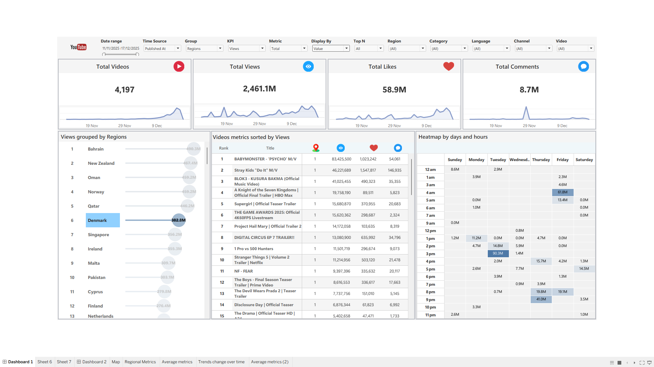
Use cases

Slide 20
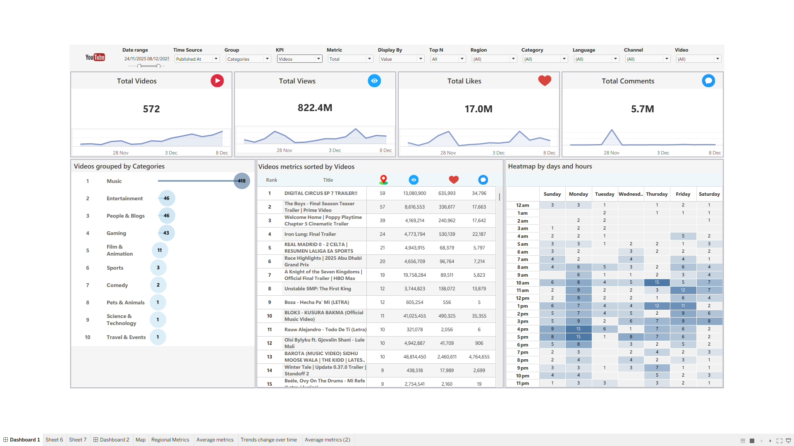
Use cases

Slide 21
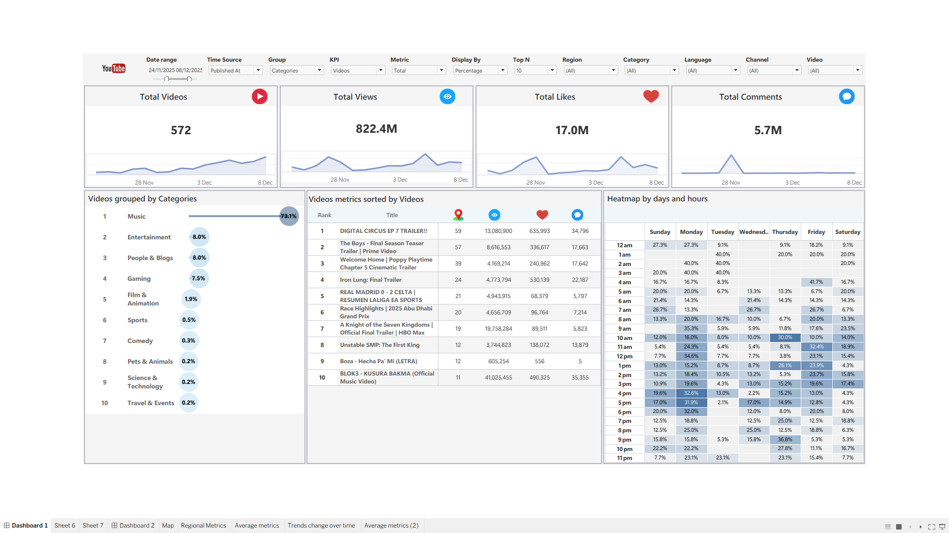
Use cases

Slide 22
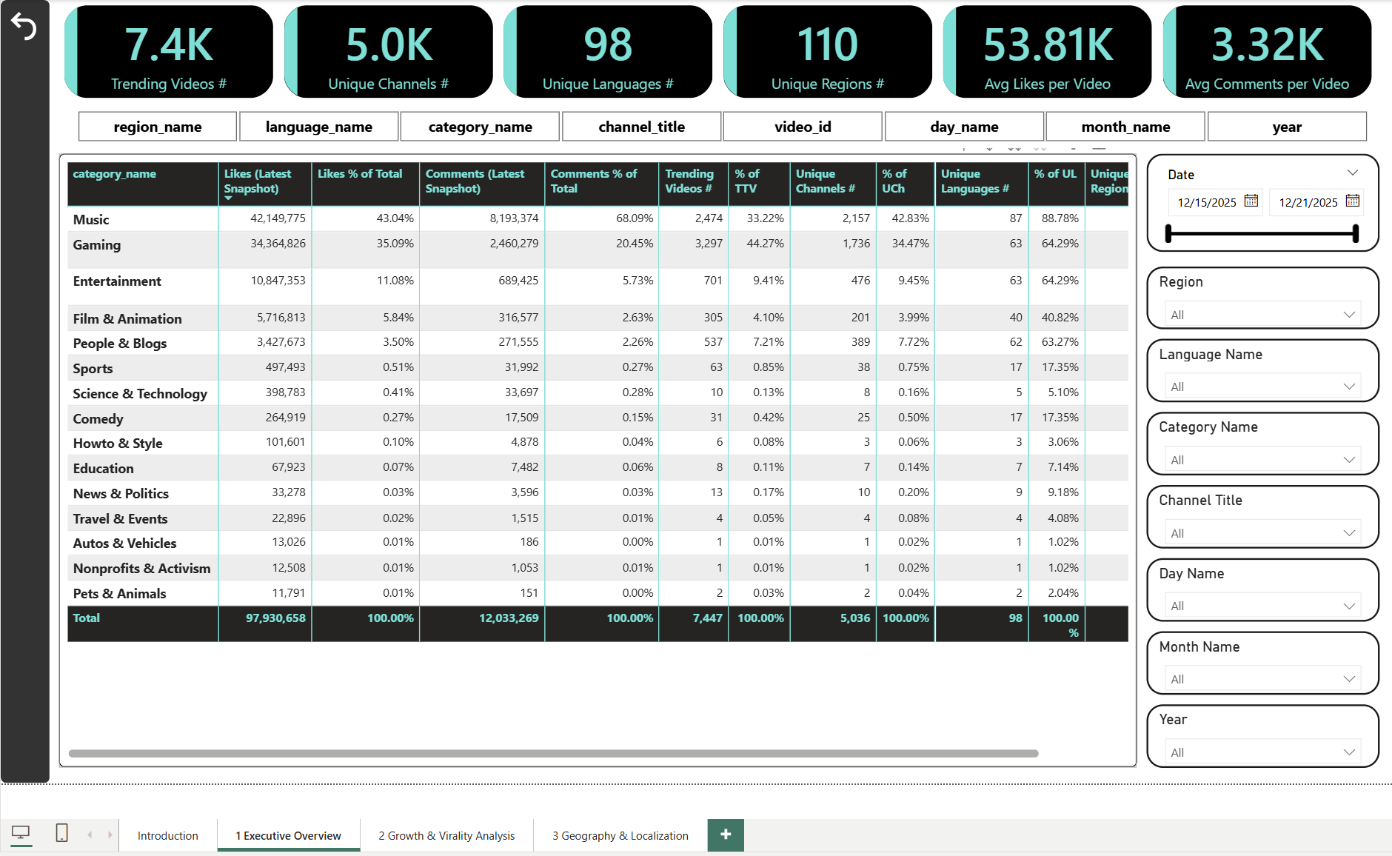

Use cases

Slide 23
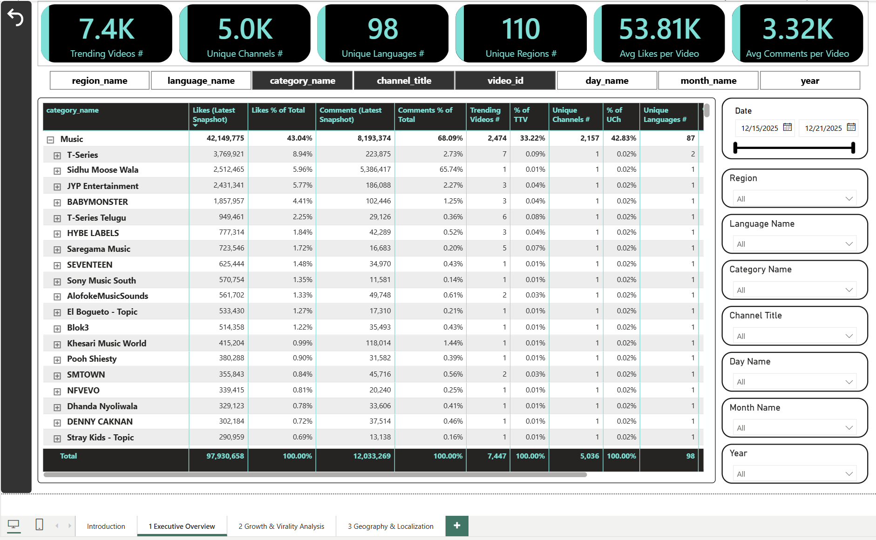

Use cases

Slide 24


Challenges
Defined the project scope through research, including data sources, ingestion frequency, and modeling strategy.
Coordinating development across multiple machines, ensuring consistent environments and reproducible results.
Designing modular, object-oriented data ingestion and Spark processing components for maintainability and scalability.
Configuring and integrating a multi-container lakehouse stack, enabling reliable communication between Kafka, Spark, Iceberg, Hive Metastore, MinIO, dbt, and Airflow.
Building a solid understanding of lakehouse concepts through hands-on implementation of Iceberg table management and Spark processing.
Implementing incremental dbt models via Spark Thrift Server and delivering a comprehensive analytical dashboard on top of the curated data.

Slide 25


Q&A and Wrap up

